Slide 1
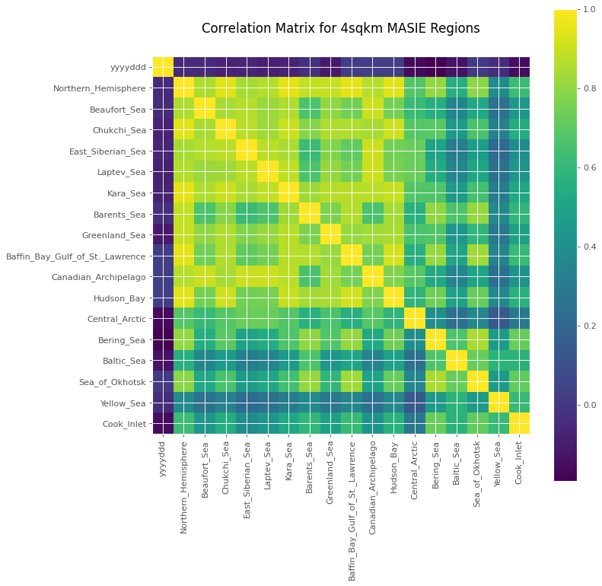

Slide 2
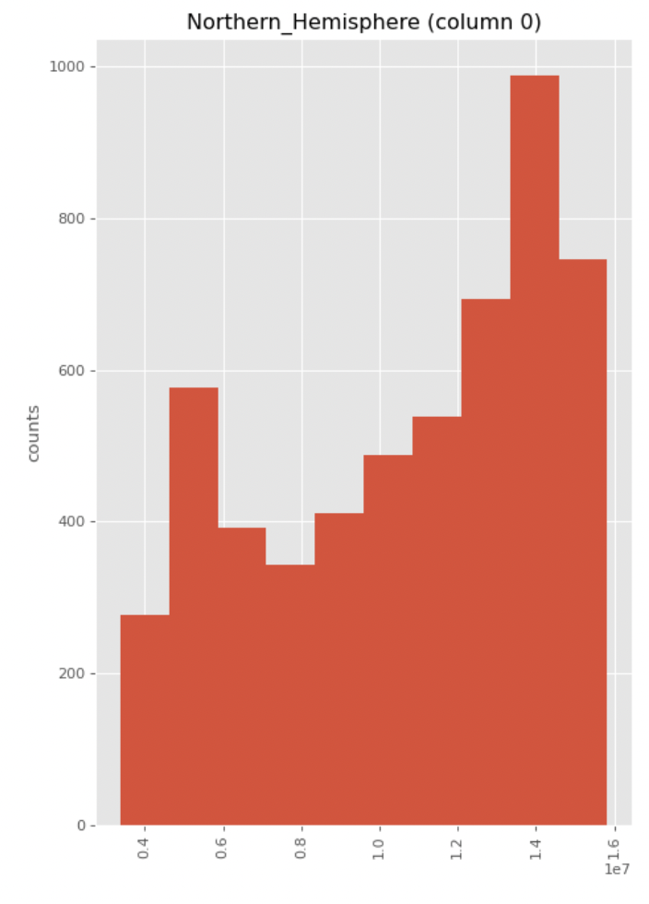
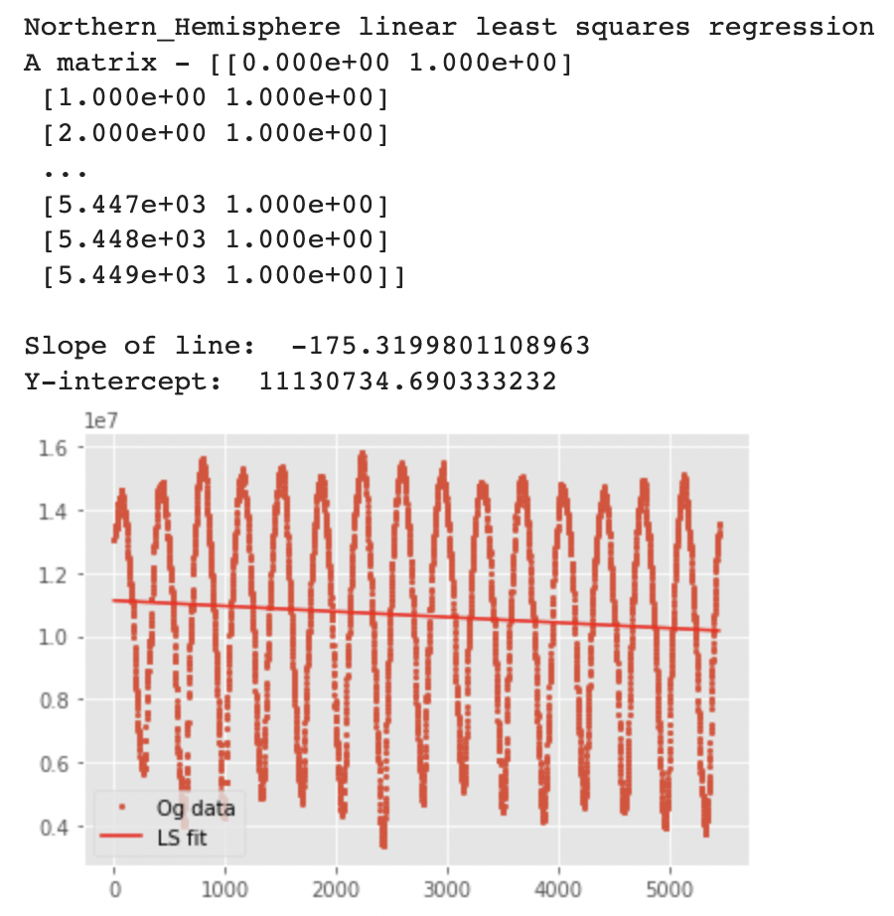
Number of Days
MASIE Measurement (km²)
MASIE Measurement (km²)
Days Since Jan 1, 2006

Slide 3
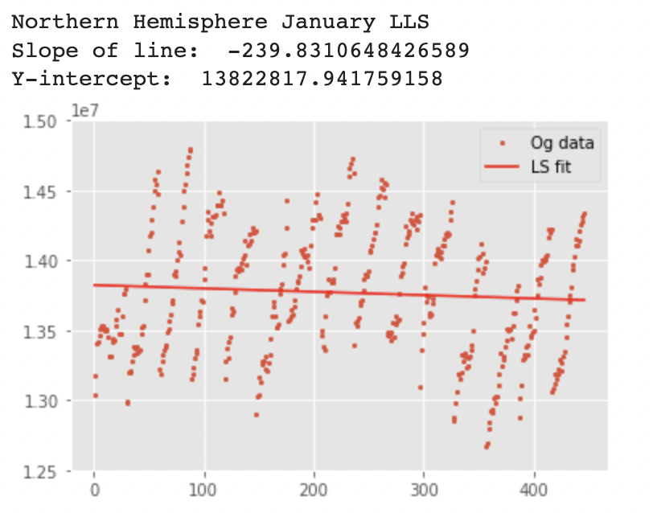
MASIE Measurement (km²)
January Days Since Jan 1, 2006

Slide 4
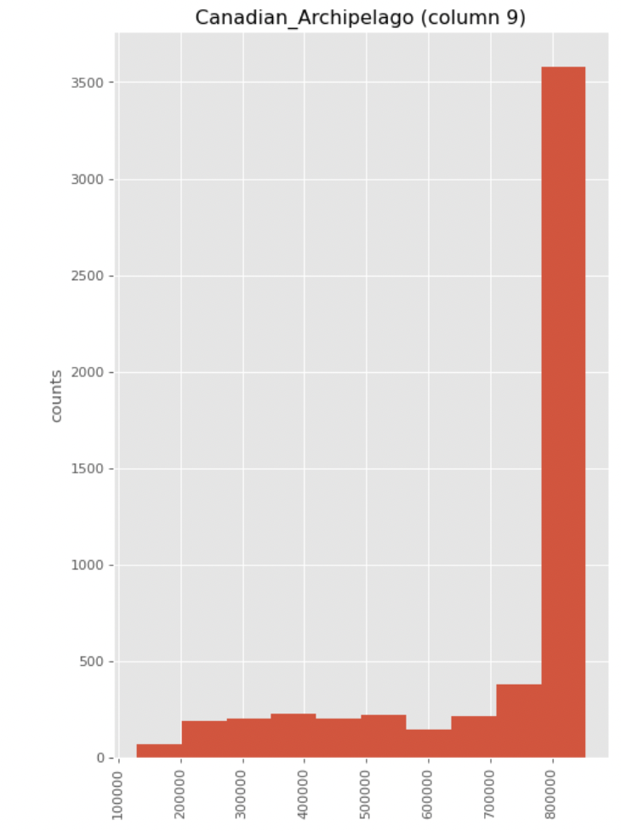
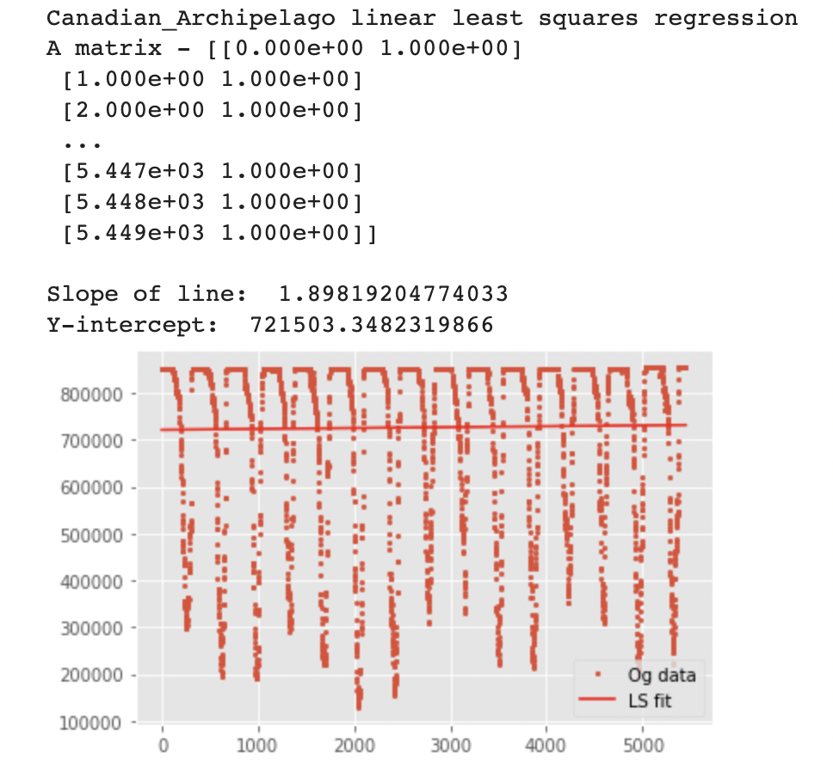
Number of Days
MASIE Measurement (km²)
MASIE Measurement (km²)
Days Since Jan 1, 2006

Slide 5
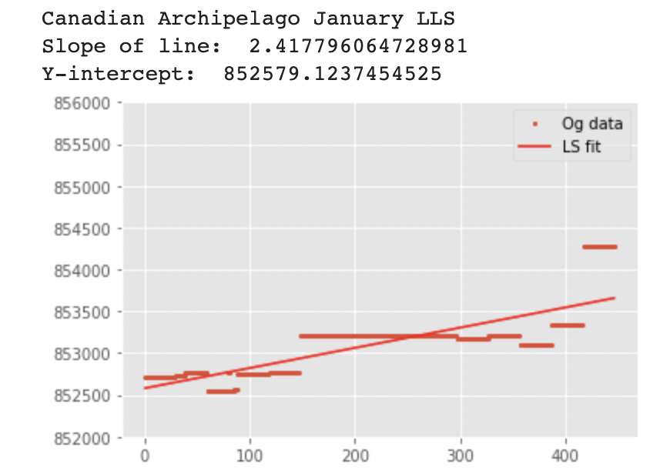
MASIE Measurement (km²)
January Days Since Jan 1, 2006

Slide 6
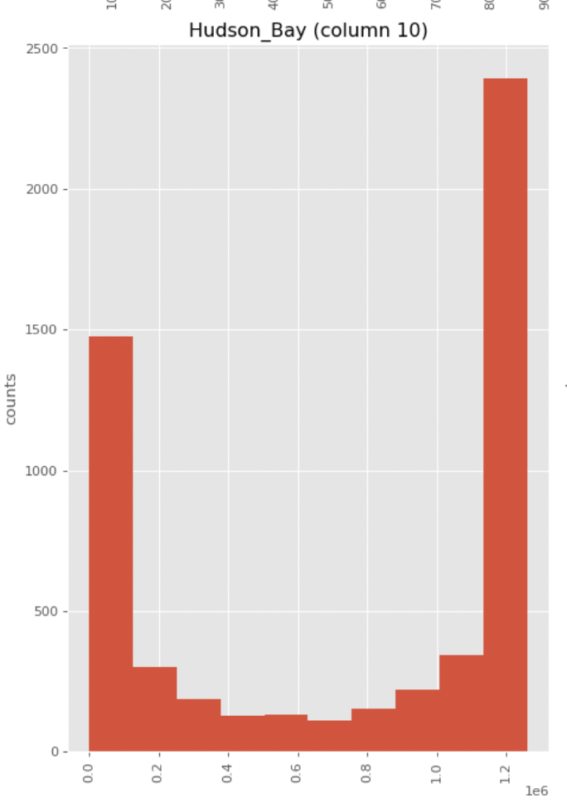
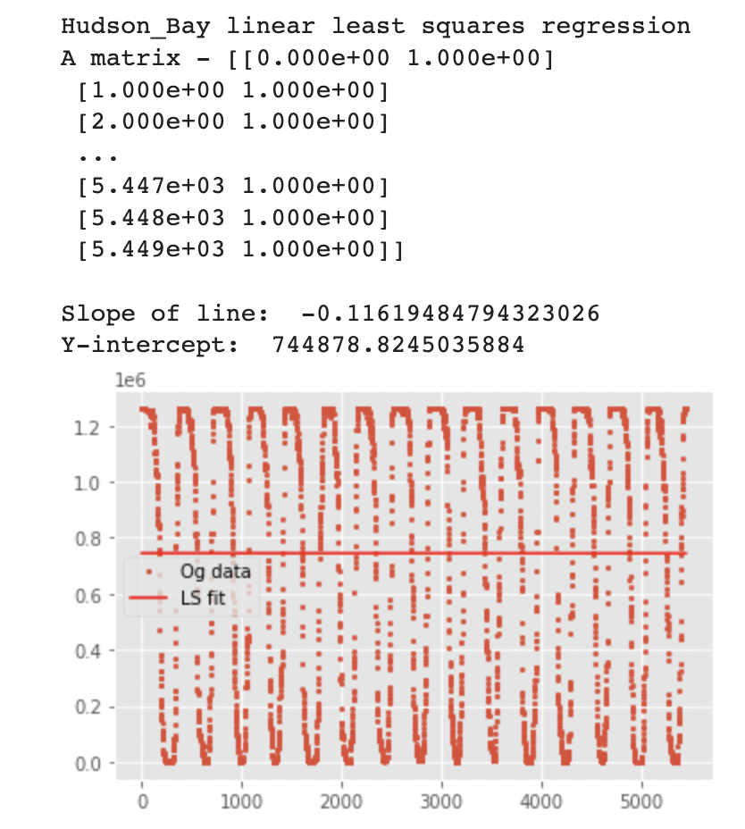
Number of Days
MASIE Measurement (km²)
MASIE Measurement (km²)
Days Since Jan 1, 2006

Slide 7
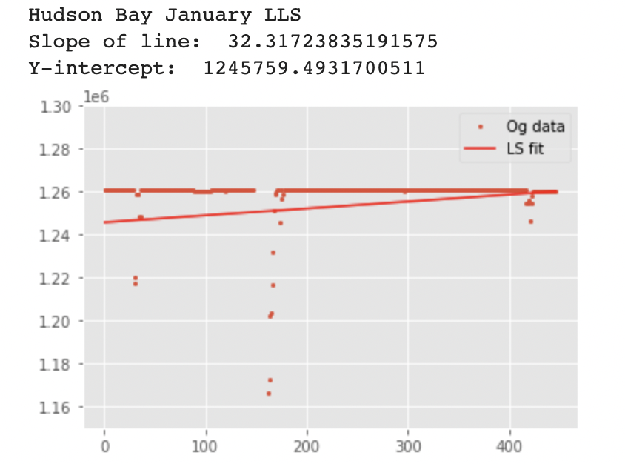
MASIE Measurement (km²)
January Days Since Jan 1, 2006

Slide 8
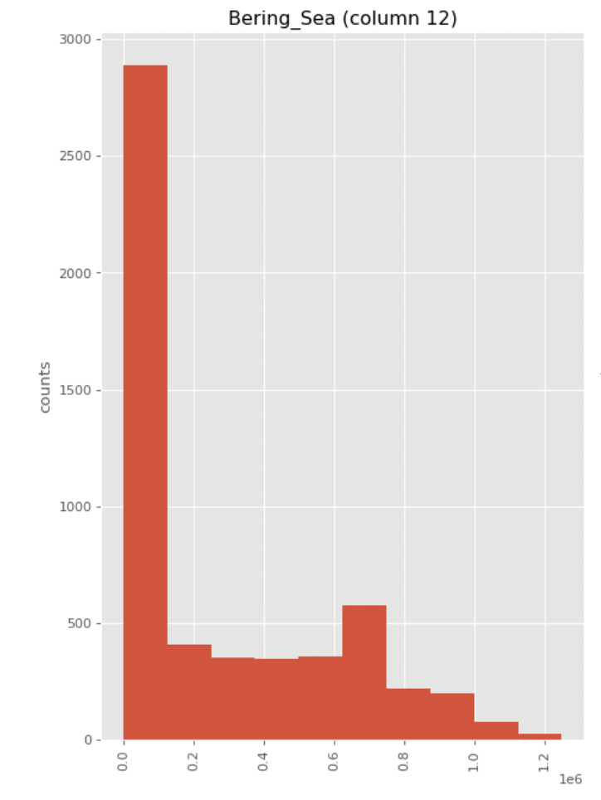
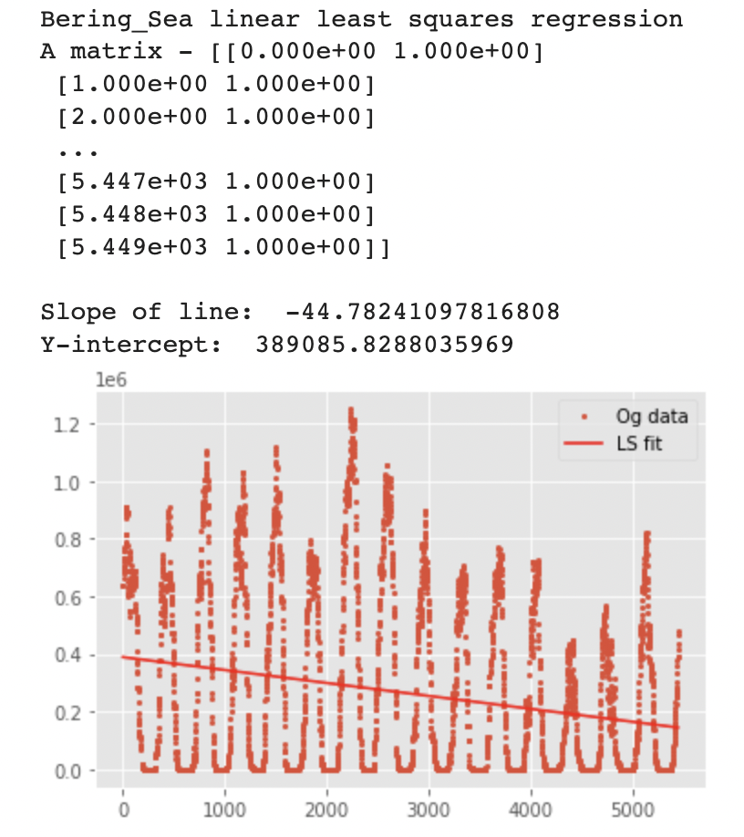
Number of Days
MASIE Measurement (km²)
MASIE Measurement (km²)
Days Since Jan 1, 2006

Slide 9
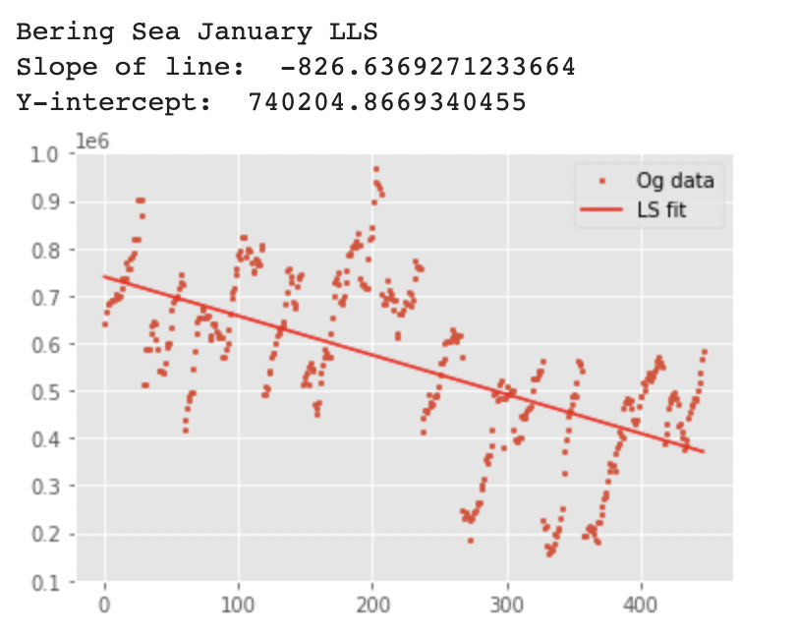
MASIE Measurement (km²)
January Days Since Jan 1, 2006

